Slide 1







www.reallygreatsite.com
CO2 EMISSIONS & CLIMATE CHANGE
The role of agricultural practices in addressing climate change

Slide 2

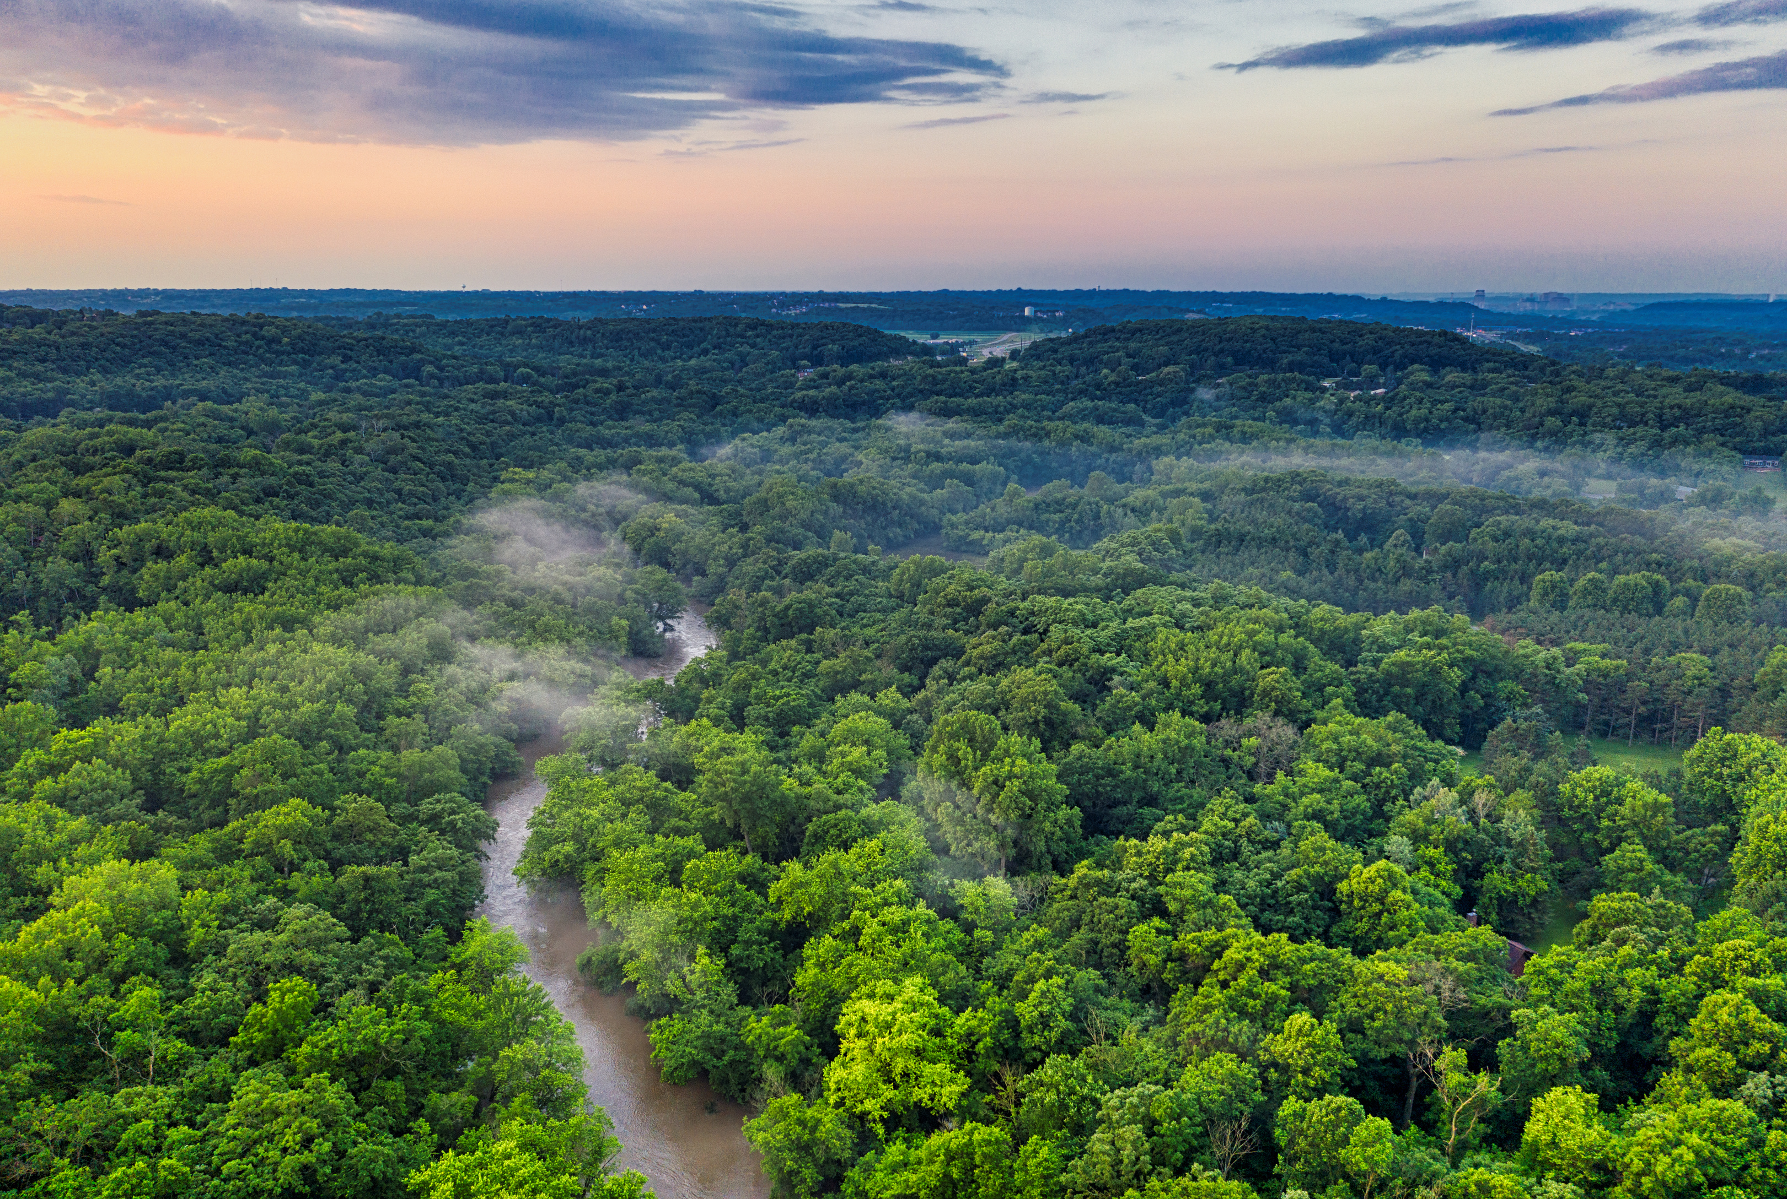
Carbon dioxide (CO2) emissions are a major cause of climate change. They come from activities like burning fuel, deforestation, and farming. These emissions trap heat in the atmosphere, leading to rising temperatures and extreme weather.
The agri-food sector is a big contributor to CO2 emissions, from growing crops and raising animals to food processing and waste. To fight climate change, we need to understand these emissions and find ways to reduce them through sustainable practices.

Slide 3


Introduction
Problem statement: With the use of agricultural emissions and other environmental variables, can a regression model be used to forecast temperature variances?
Objective: Predict the effect of CO2 emissions on climate change from the agri-food sector

Slide 4
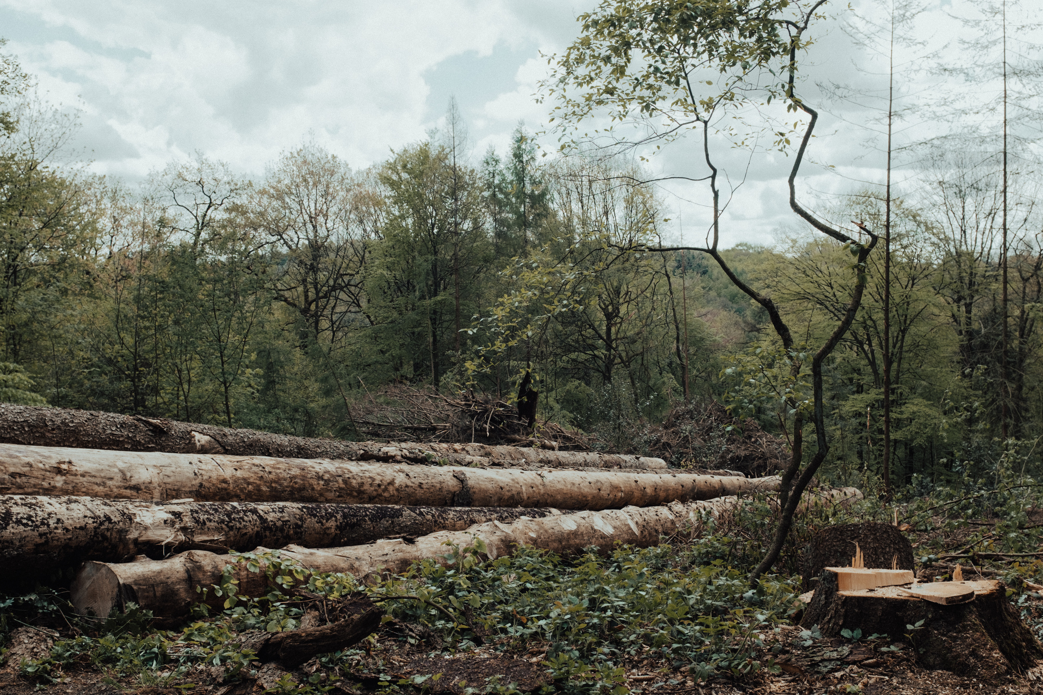
Data Preprocessing
Handling Missing data
Removing duplicates
Filtering out countries with less observations

Slide 5
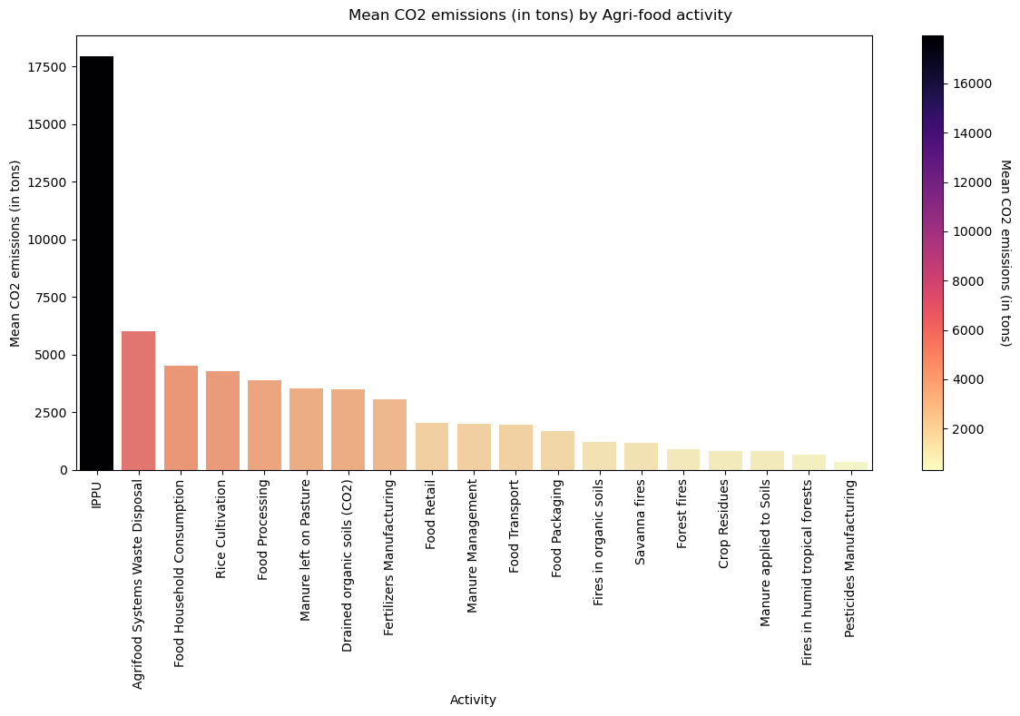

Average CO2 Emissions per Activity in the Agri-Food Sector
The feature IPPU has the
highest mean value compared
to all other features.
This indicates that emissions
or contributions from industrial processes and product use
are the most significant contributor towards emissions.

Slide 6
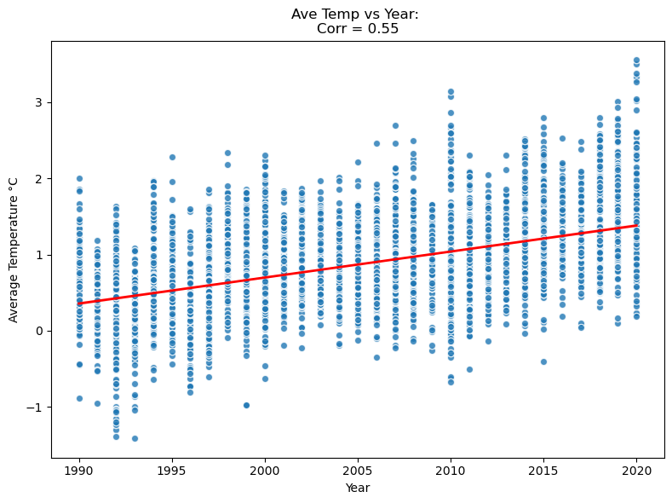


Average Temperature vs Year

Slide 7
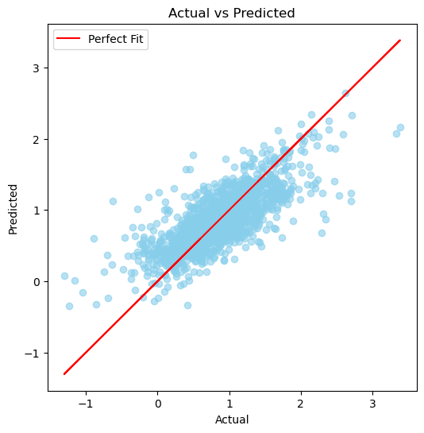

Chosen Predictive
Model and Accuracy
Performance Metrics:
R² Score: The model ( random forest) explains 59% of the variation in the data, indicating a decent fit, but there is still room for improvement.
MAE (Mean Absolute Error): On average, the model's predictions are off by about 0.256.
MSE (Mean Squared Error): The average squared difference between the actual and predicted values is 0.12188, suggesting small errors.
xxxxx

Slide 8
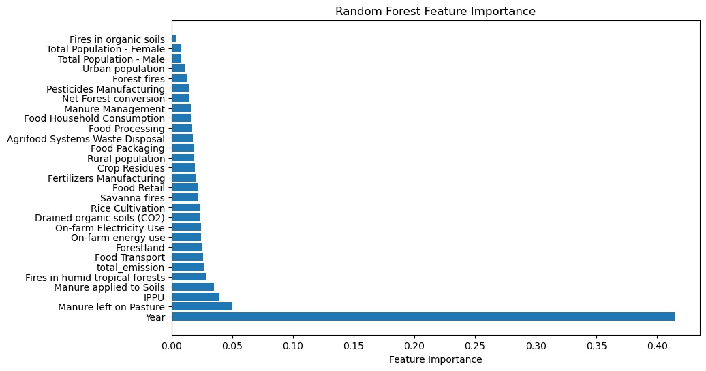
Most Influential Factors

Slide 9

Policy Recommendations
These recommendations focus on the sectors with the greatest influence on temperature rise, offering targeted strategies to mitigate climate change effectively:
Reduce Manure Emissions
Implement sustainable manure management practices (e.g., anaerobic digestion, composting) to minimize methane release.
Promote alternative fertilizers and soil health practices to reduce dependency on livestock waste.
Address IPPU (Industrial Processes and Product Use)
Transition to low-carbon technologies in industrial processes (e.g., cement, steel production).
Encourage circular economy models, focusing on reducing waste and increasing resource efficiency in industries.
Optimize Food Transport Emissions
Support local food production to reduce the carbon footprint of food transportation.
Promote greener transportation options, such as electric vehicles and efficient logistics systems.
Protect and Restore Forest Land
Strengthen policies for forest conservation and reforestation to act as carbon sinks.
Promote sustainable land use practices to balance agricultural needs with ecosystem preservation.

Slide 10
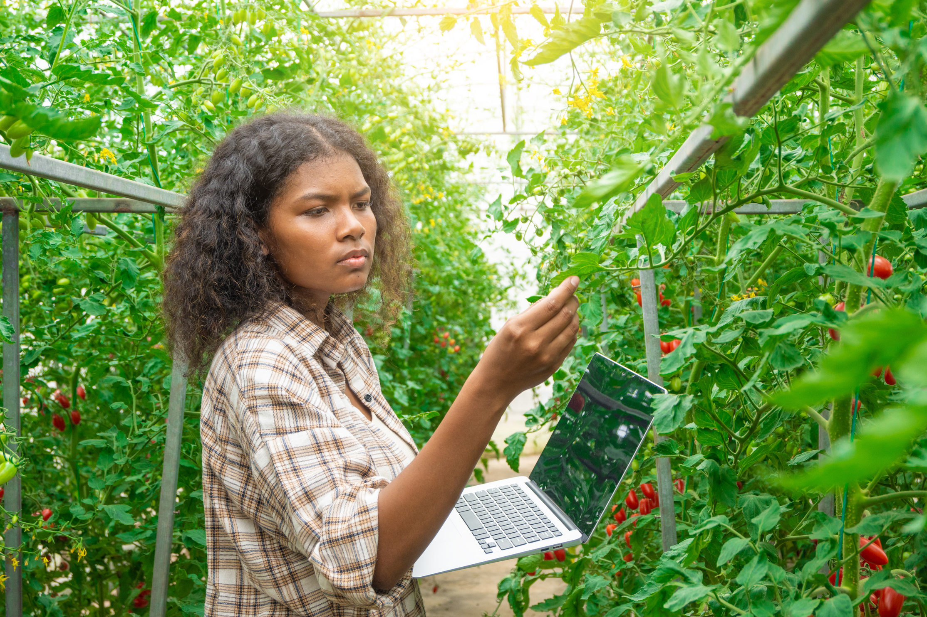
Conclusion
The model serves as a valuable tool for guiding policy decisions, providing insights into the most impactful areas of agricultural emissions, and helping to shape future environmental strategies.
Technological solutions such as better manure treatment technologies, more sustainable agricultural practices, and transitioning to cleaner transport options should be explored and incentivized.

Slide 11

THANK YOU!
Group 6

